Slide 1
OpenGL HW4
Computer Graphics
May 29, 2019
CGV Lab, NTHUCS

Slide 2
Outline
How to submit your homework
Report
Goal
Grading principle

Slide 3
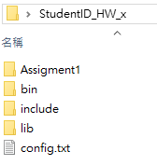
How to submit your homework
Check your folder structure
Folder name: StudentID_HW_x

Slide 4
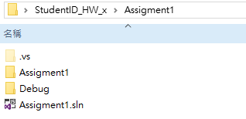
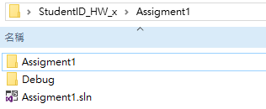
How to submit your homework
In “StudentID_HW_x\Assigment4”
Delete “.vs”(hidden folder)

Slide 5
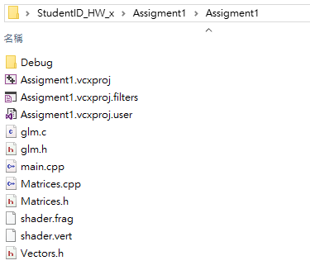
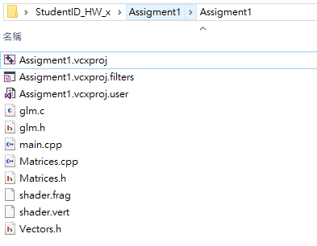
How to submit your homework
In “StudentID_HW_x\Assigment4\Assigment4” delete “Release” and ”Debug” folders

Slide 6
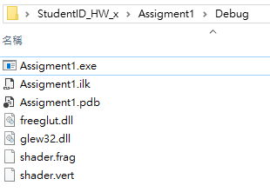
How to submit your homework.
In “StudentID_HW_x\Assigment4\Assigment4”
Copy your shader to “StudentID_HW_x\Assigment2\Debug
(Release)”.
Make sure your execution file in “Debug(Release)” can run.

Slide 7
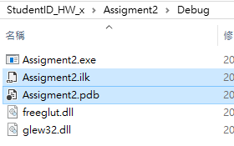
How to submit your homework.
Delete the *.pdb, *.ipdb, *.iobj and *.ilk files in “Debug(Release)”

Slide 8
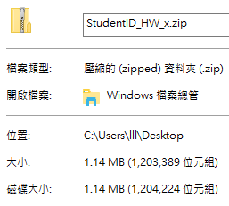
How to submit your homework.
Zip the “StudentID_HW_x” folder into “StudentID_HW_x.zip”.
Please make sure your zip file DOES NOT contain the “ColorModels“ folder.
Please make sure your zip file size about 1MB.

Slide 9
How to submit your homework
Upload the “StudentID_HW_x.zip” to iLMS
Name your iLMS assignment page title
“HW2_yourStudentID_name”.

Slide 10
Goal
Mapping the texture on models correctly.
Lighting on textured models correctly.
Can modification texture parameters in different filtering and wrapping mode.

Slide 11
Grading principle
Total score: 100
Correctly render textured model (30%)
Manually control texture filtering and wrapping mode(25%)
Texture mipmap(25%)
Print information(10%)
Report (10%)

